Slide 1
Data Analyst Road Map- CDF
Presented by Sai Bharath Kanasani -Data Analyst Trainer

Slide 2
AGENDA
Introduction
Data Collection
Data Cleaning
Data Validation
Visualization
Reference
Summary

Slide 3

INTRODUCTION
Hello, peer Congratulations on joining the team! At Community Dreams Foundation.

Slide 4
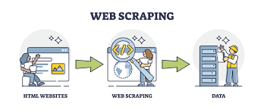
Data COLLECTION
Web Scrapping
As a data analyst, the basic part is collecting the project’s data. Here In our project, we need to collect incentive data from various websites from the government or private websites by using web scrapping.
In our team, we use a common API to scrap the data which is Selenium an automated bot that extracts the data from the website in a fast and effective way, and with it, we include the Beautiful Soup. And to structure the data we use Python pandas to frame the data.

Slide 5
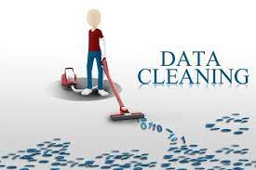
Data CLEANING
Data Cleaning
It is the second step of our project. In this step, we are transforming data into our needs adding columns analyzing the data, finding the empty files, and clearing the issues
Note: We are not deleting any kind of data here this is because of the project requirements

Slide 6
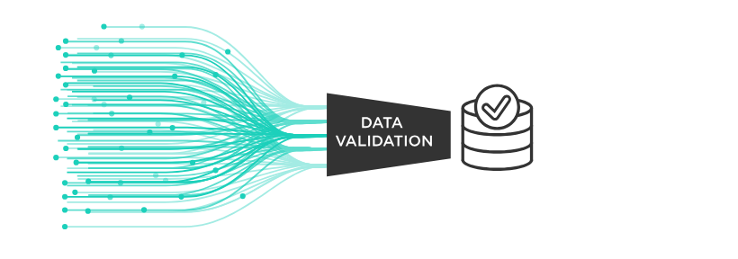
Data Validation
Data Validation
In this step, we are making a few changes to the structure of our data like adding multiple columns in a dictionary format.
This is the step where we check the data quality and find the right structure for our data to store in the database for use in the future.

Slide 7
VISUALIZATION
Data Visualization
To analyze vast amounts of data and make data-driven decisions in the world of big data, data visualization tools and technologies are crucial.
To get a better understanding of the data that we have we use visualization techniques to check the whole data we have. We use these visualizations to give a clear picture to our customers and stakeholders so that we can make better decisions in our project.
For Visualization, we use multiple BI tools like Power BI, Tableau, Google Labs, and Excel.

Slide 8
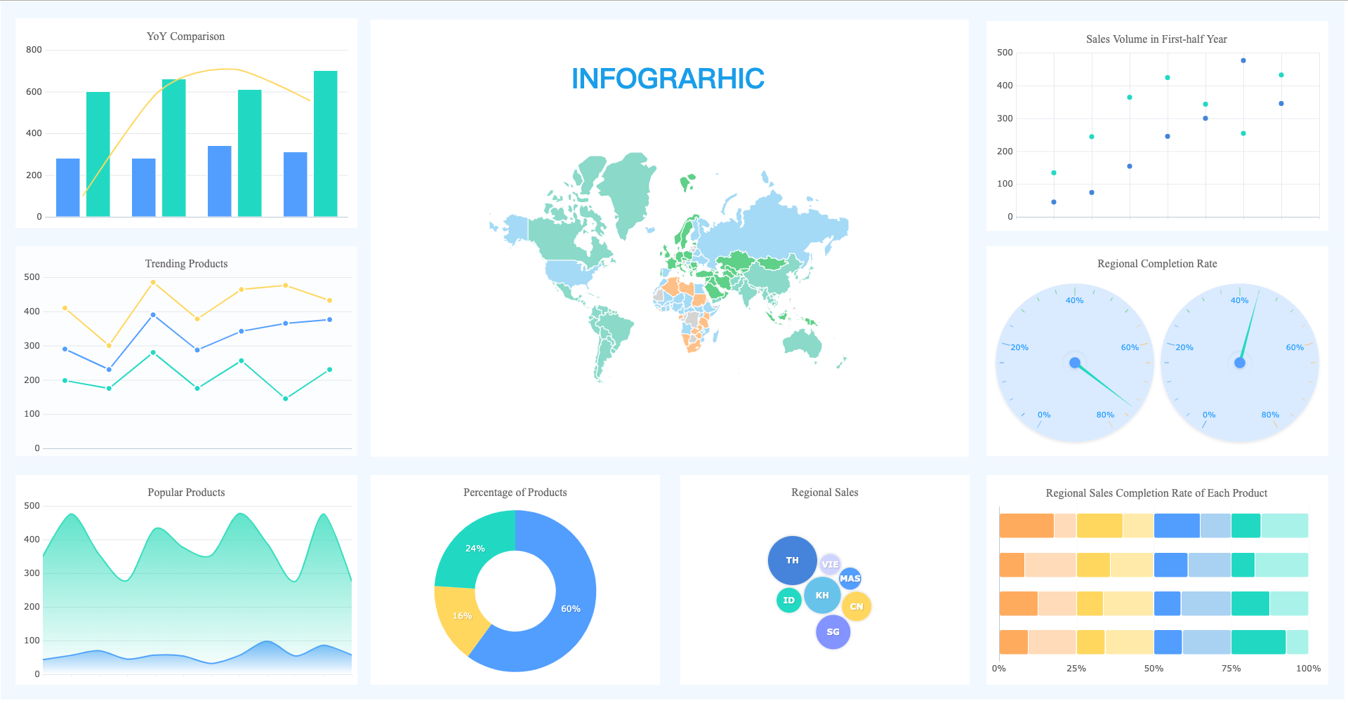

Slide 9
References
Here are some references to you. And the best part is to do your own research so that you can gain a good amount of understanding of the problem.
Web Scrapping:
YouTube: https://www.youtube.com/@ThePyCoach
Blogs: https://www.zenrows.com/blog/selenium-python-web-scraping
Data Cleaning:
YouTube: https://www.youtube.com/@AlexTheAnalyst/about
Blogs: https://www.w3schools.com/python/pandas/pandas_cleaning.asp
Visualization:
You Tube: https://www.youtube.com/@KevinStratvert
Blogs: https://www.tableau.com/learn/articles/data-visualization
Reference 1: Sai Bharath Kanasani- https://github.com/Saibharathkanasani/Data-Analyst-CDF-.git
Reference 2: Rashmi Khadse - https://github.com/rashmikhadse/Incentives-Recommendation-Engine
Reference 3: Ren Guan - https://github.com/PerfectEnvoyRG/ArizonaCitiesExtractionCode

Slide 10
Summary
In this presentation, we only covered the basic lifecycle of a data analyst of the incentives data team. However, the best way to complete the task is to collaborate with the other peers in your team. The above slide references are approved by the organization and team lead. While performing the task every task has its own set of standard rules and regulations to follow which are given by the team lead or organization.
Use this as the basic reference for completing each task the team lead assigns. All the Best!

Slide 11
THANK YOU
ONE TEAM ONE DREAM!

